Slide 1
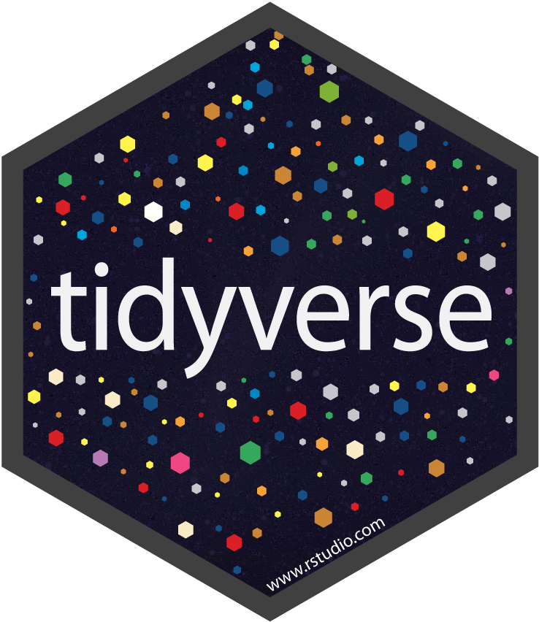
MASTER THE TIDYVERSE
Mike K Smith
Autumn 2019
Materials used in this course are derived from
https://github.com/rstudio-education/master-the-tidyverse/
and are shared under a CC-BY-SA-4.0 license.

Slide 2

HELLO
my name is
Mike
 @MikeKSmith
MikeKSmith
CC BY-SA RStudio
Notes:
* introduce yourself

Slide 3
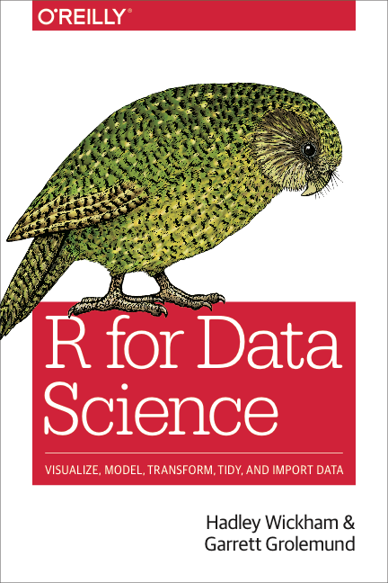
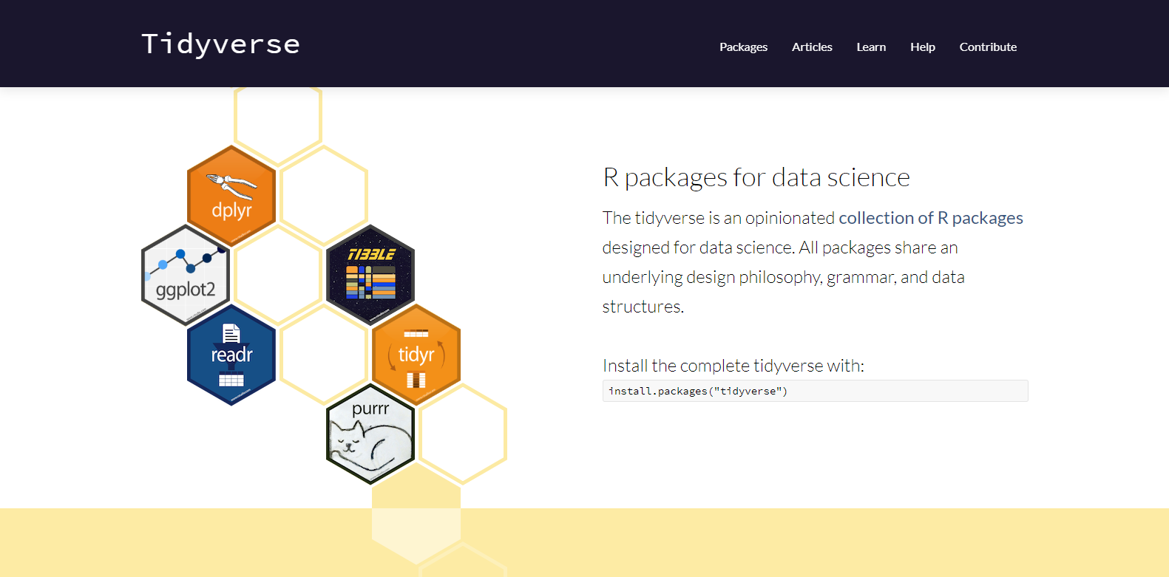
http://tidyverse.org
https://r4ds.had.co.nz/
CC BY-SA RStudio

Slide 4
Introduction and Visualize Data | 15th Nov
Transform & Tidy Data | 22nd Nov
Importing Data | 29th Nov
Data Types | 6th Dec
Iteration & Modelling | 13th Dec
CC BY-SA RStudio

Slide 5
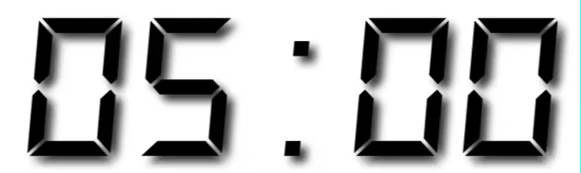
Your Turn
Form groups of 2-4 people. Introduce yourself to your group members. Tell them:
Who you are
What you do with data
Share a boring fact about yourself
Notes:
* get students discussing immediately to set the tone for participation

Slide 6

Why

Slide 7
Why not Python,
SAS,
Julia,
Stan,
…

Slide 8
and Python,
SAS,
Julia,
Stan,
…

Slide 9
Collect
Data
The (data) scientific method
Design Experiment
Explore or Test
Form Hypothesis
Communicate Results
CC BY-SA RStudio
Notes:
But let’s take a moment to remind ourselves about how science works…
We first form a hypothesis, we use this to drive a particular experimental design
We collect data
We then analyse this data
And finally we should communicate our results with others in order to move forward science.

Slide 10
Import data into software
Collect
Data
Tidy data into useable form
Design Experiment
Explore or Test
Form Hypothesis
Transform the data. Do feature engineering.
Deploy app or publish paper
Write code to apply a modeling algorithm.
Build app or write paper
Visualize the data and/or results
Communicate Results
CC BY-SA RStudio
Notes:
But there’s actually a bunch of other steps involved in between each of these, and I’m showing just a few of them here
The key thing here is that *these* steps are the kinds of thing that you can use R and the tidyverse to help you with.

Slide 11
(Applied) Data Science
Import data into software
Collect
Data
Tidy data into useable form
Design Experiment
Explore or Test
Visualize
Form Hypothesis
Transform the data. Do feature engineering.
Import
Tidy
Model
Communicate
Transform
Deploy app or publish paper
Write code to apply a modeling algorithm.
Program
Build app or write paper
Visualize the data and/or results
Communicate Results
CC BY-SA RStudio
Notes:
So when you take these steps and collapse them you get a model for what we can call applied data science

Slide 12
Meet the tools:
R and RStudio

Slide 13
What is R/RStudio?
R is a statistical programming language
Although it’s growing into a general purpose programming language.
RStudio is a convenient interface for R (an integrated development environment, IDE)
Can do everything you need to do with R in one place.

Slide 14
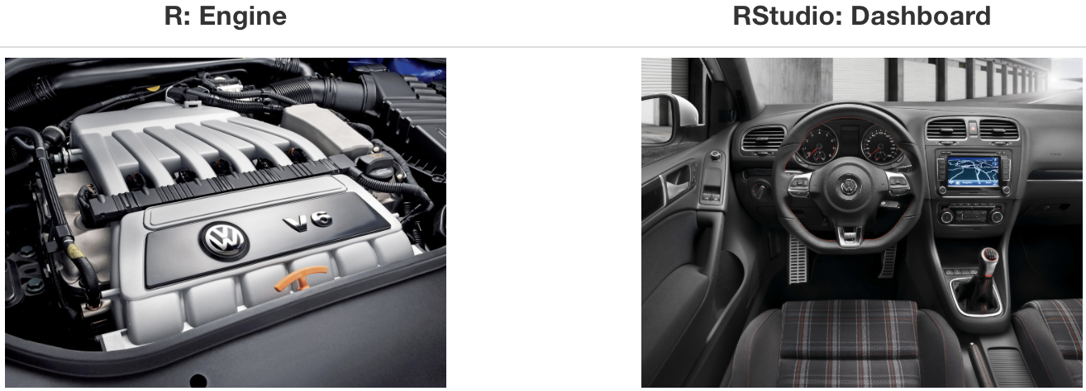
At its simplest:
Source: Modern Dive

Slide 15
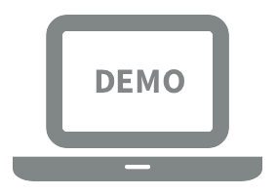
Let’s take a tour - R / RStudio

Slide 16
Concepts introduced:
Console
Saving sequences of commands in an R script
Using R as a calculator
Environment
Loading and viewing a data frame
Accessing a variable in a data frame
R functions

Slide 17
R (absolute) basics
Most things are functions:
do_this(to_this) do_that(to_this, with_these_arguments)
Assign results to an object:
myObject <- 2 * 2

Slide 18
R Packages

Slide 19




help
help
help
help
help
help
help
help
help
function1()
function2()
function3()
function4()
function4()
function5()
function6()
function7()
function7()
function8()
function9()
function10()
function11()
“base R”
R “Packages”
CC BY-SA RStudio

Slide 20
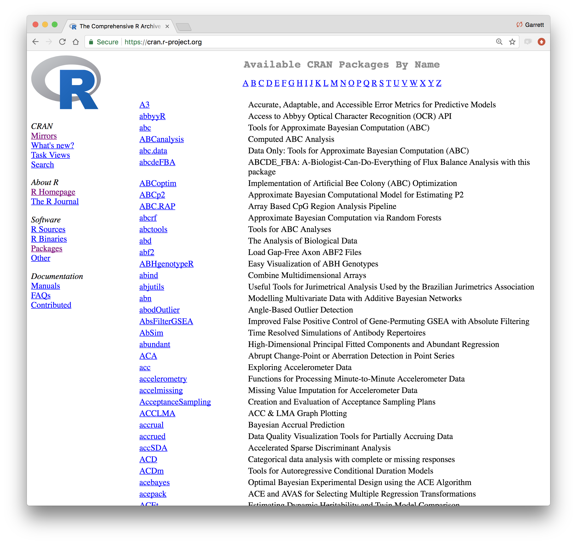
CC BY-SA RStudio

Slide 21
Using packages
1
2
install.packages("foo")
library("foo")
Downloads files to computer
Loads package
1 x per computer
1 x per R Session
CC BY-SA RStudio

Slide 22
The Tidyverse

Slide 23
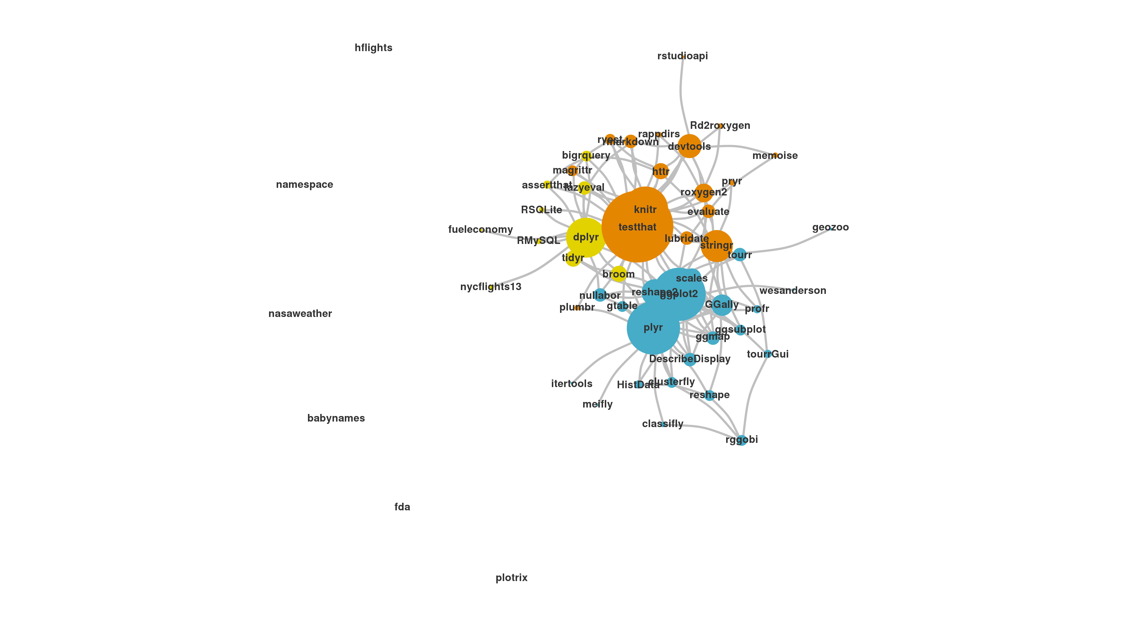
The Tidyverse
A collection of modern R packages that share common philosophies, embed best practices, and are designed to work together.
Display by Adolfo A ́lvarez
CC BY-SA RStudio

Slide 24
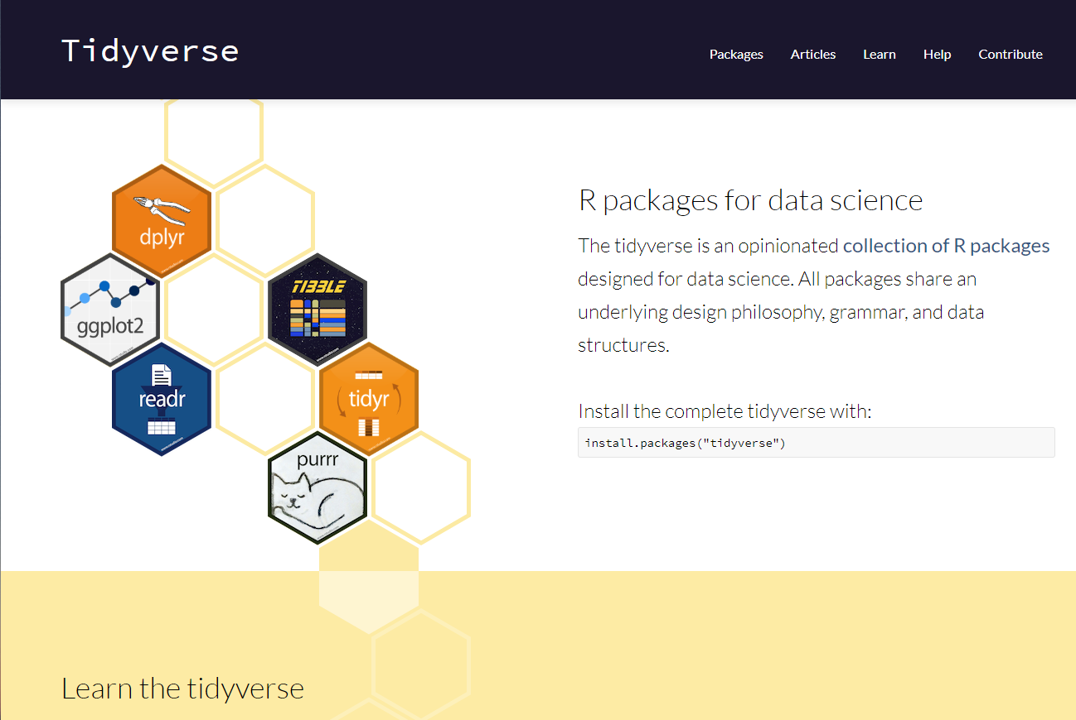
tidyverse.org
CC BY-SA RStudio

Slide 25
tidyverse
An R package that serves as a short cut for installing and loading the components of the tidyverse.
library("tidyverse")
CC BY-SA RStudio

Slide 26
install.packages("tidyverse")
does the equivalent of
install.packages("ggplot2")
install.packages("dplyr")
install.packages("tidyr")
install.packages("readr")
install.packages("purrr")
install.packages("tibble")
install.packages("hms")
install.packages("stringr")
install.packages("lubridate")
install.packages("forcats")
install.packages("DBI")
install.packages("haven")
install.packages("httr")
install.packages("jsonlite")
install.packages("readxl")
install.packages("rvest")
install.packages("xml2")
install.packages("modelr")
install.packages("broom")
CC BY-SA RStudio

Slide 27
install.packages("tidyverse")
library("tidyverse")
does the equivalent of
does the equivalent of
install.packages("ggplot2")
install.packages("dplyr")
install.packages("tidyr")
install.packages("readr")
install.packages("purrr")
install.packages("tibble")
install.packages("hms")
install.packages("stringr")
install.packages("lubridate")
install.packages("forcats")
install.packages("DBI")
install.packages("haven")
install.packages("httr")
install.packages("jsonlite")
install.packages("readxl")
install.packages("rvest")
install.packages("xml2")
install.packages("modelr")
install.packages("broom")
library("ggplot2")
library("dplyr")
library("tidyr")
library("readr")
library("purrr")
library("tibble")
CC BY-SA RStudio

Slide 28
Tidy tools
Functions are easiest to use when they are:
Simple - They do one thing, and they do it well
Composable - They can be combined with other functions for multi-step operations
Smart - They can use R objects as input.
Tidy functions do these things in a specific way.
CC BY-SA RStudio

Slide 29
Tidy data
Tidy functions all expect and return the same data structure, known as tidy data:
CC BY-SA RStudio

Slide 30

What do you mean by “tidy”?
Notes:
So here’s the crux of the tidy idea (and it’s not too peculiar):
Each variable in a dataset should be in one column.
Each observation should be on a row.
Each cell should represent one value.

Slide 31
Reproducibility

Slide 32
GOAL: Reproducible data analysis

Slide 33
Reproducibility checklist
What does it mean for a data analysis to be “reproducible”?
Near-term goals:
Are the tables and figures reproducible from the code and data?
Does the code actually do what you think it does?
In addition to what was done, is it clear why it was done? (e.g., how were parameter settings chosen?)
Long-term goals:
Can the code be used for other data?
Can you extend the code to do other things?

Slide 34
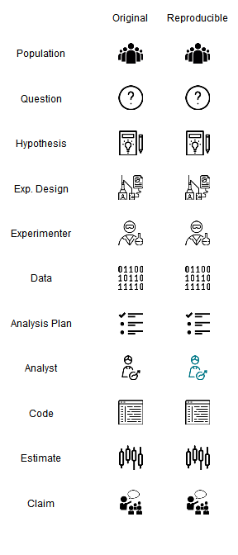
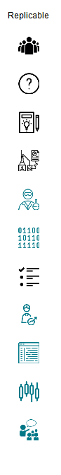

Aside: reproducibility vs replicability

Slide 35
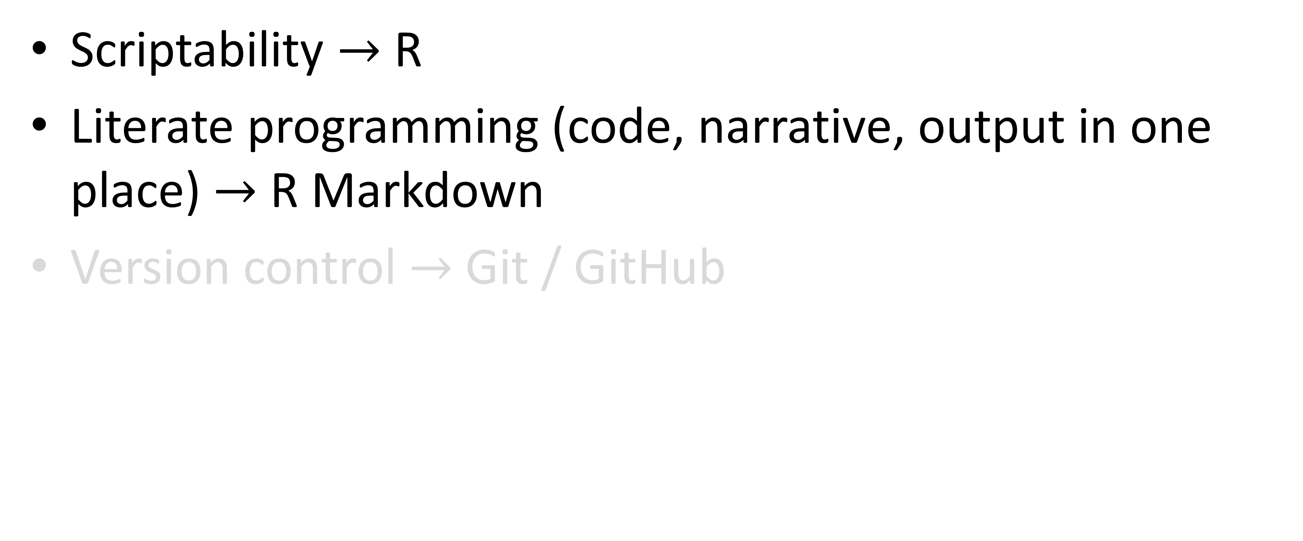
Toolkit
Scriptability $→$ R
Literate programming (code, narrative, output in one place) $→$ R Markdown
Version control $→$ Git / GitHub

Slide 36
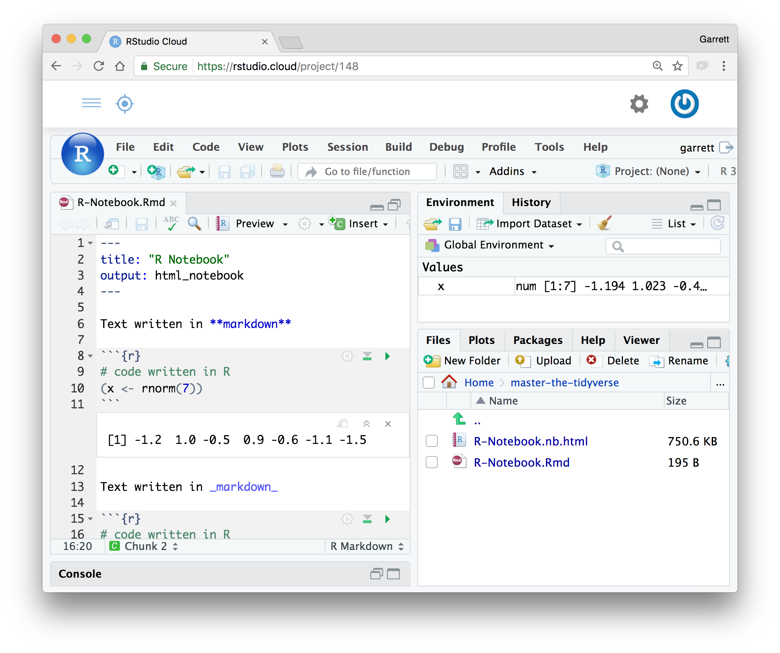
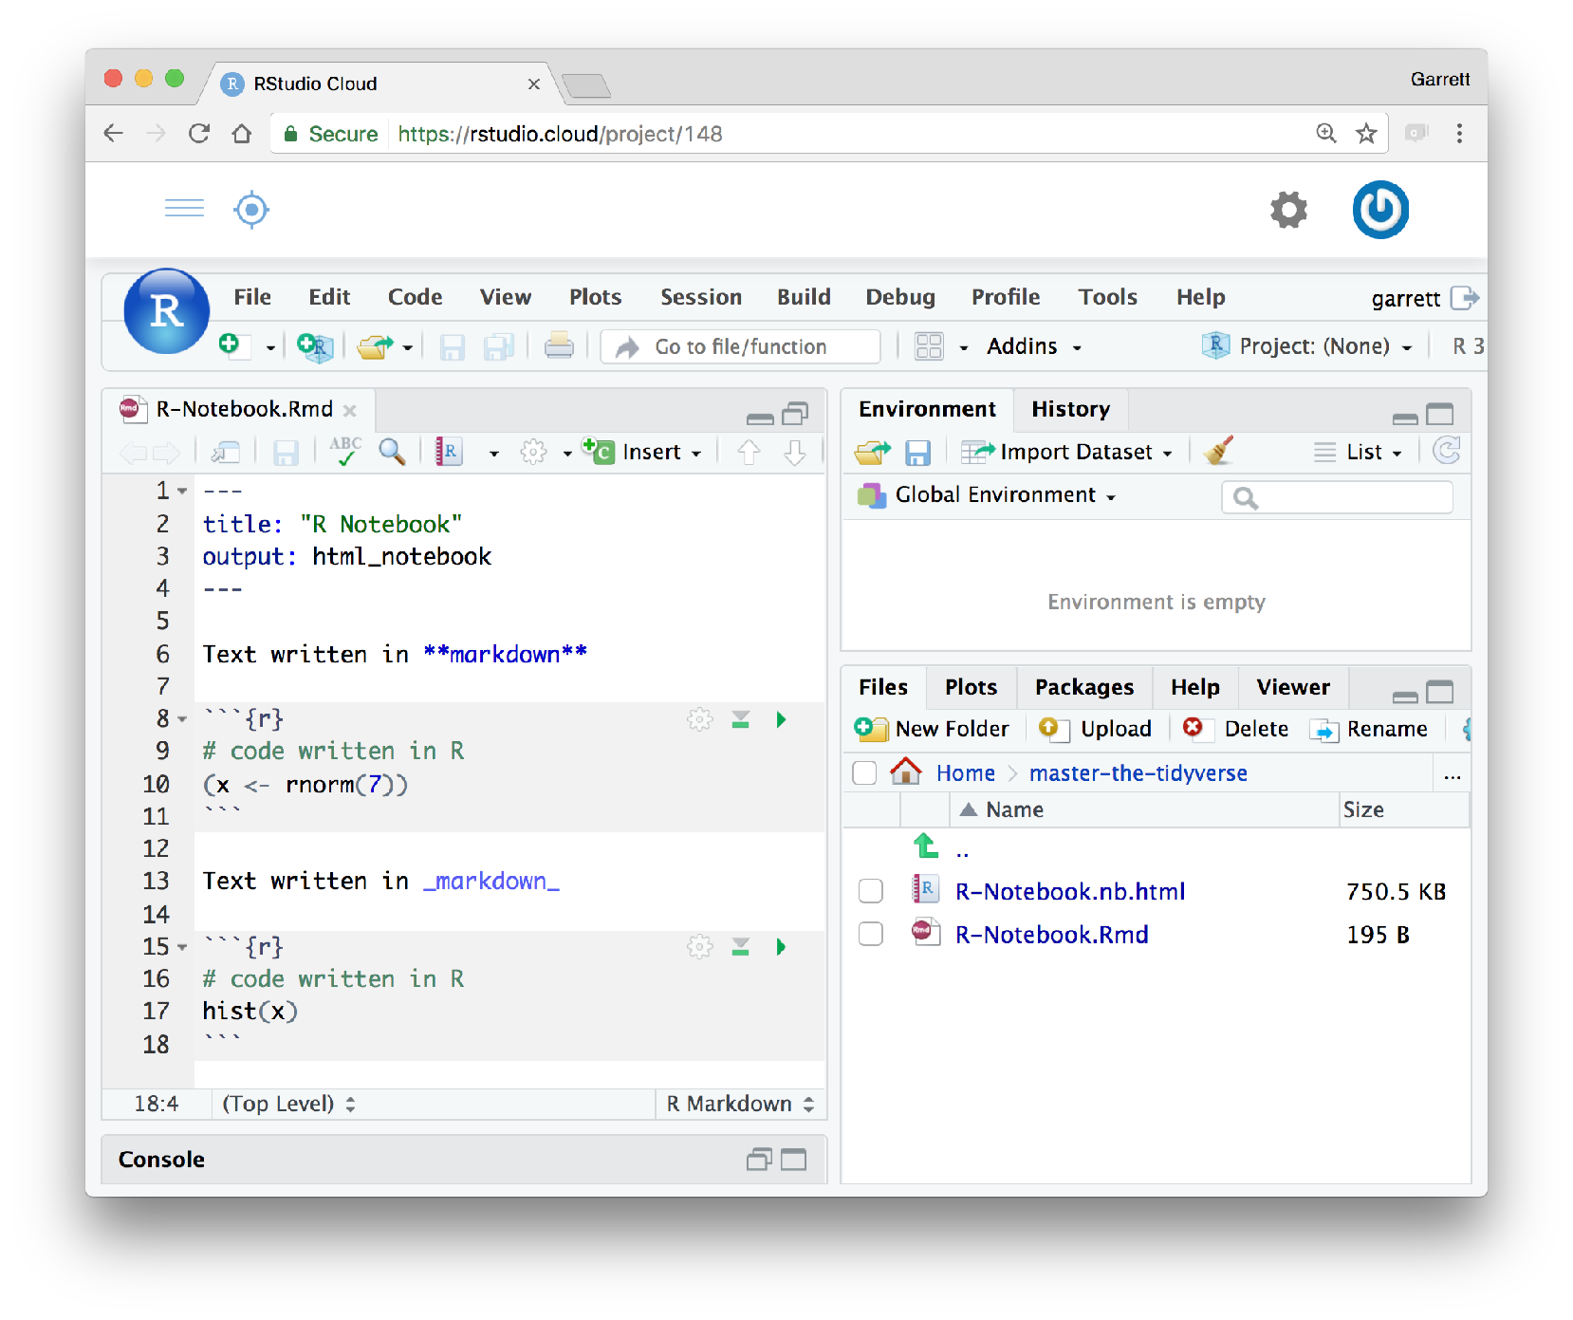
R Notebooks
An authoring format for Data Science.
Click to run all code chunks above
Click to run code in chunk
Code result
CC BY-SA RStudio

Slide 37
Your Turn
Open 00-Introduction.Rmd. Read through the notebook and do everything it tells you to do.

